Slide 1


Serve the Earth and Space Community
The application of “Nuwa” Satellite Constellation and PIE-NWP
PIESAT Information Technology Co., Ltd.

Slide 2

CONTENTS
1
Introduction of PIESAT
2
PIESAT “Nuwa” constellation
3
Introduction of PIE-NWP
4
Remote sensing data applications

Slide 3
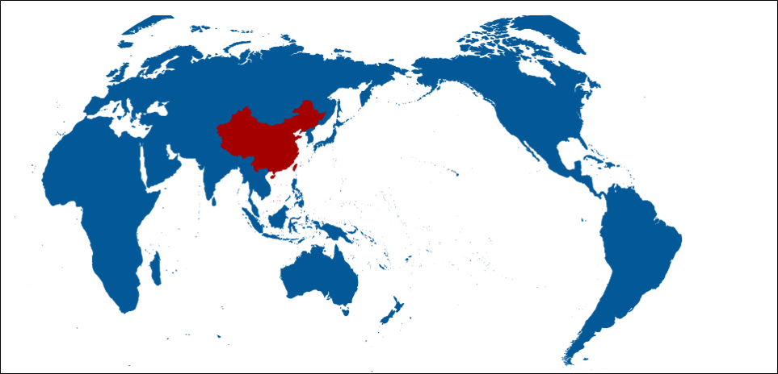
Introduction of PIESAT
PIESAT is a leading satellite operation and application service provider in China since 2008.
United Kingdom
Denmark
Switzerland
Romania
UAE
Pakistan
Beijing
India
Laos
Hong Kong
(China)
Ethiopia
Thailand
Cambodia
Singapore
15
Chile
Australia
Wholly-owned Subsidiaries

Slide 4
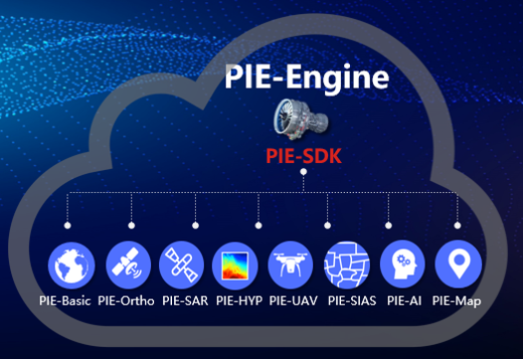
Introduction of PIESAT
PIE - Pixel Information Expert
Flagship software product for remote sensing data processing.
Natural Resource Application
Emergency Management Application
Ecological Environment Application
Meteorology & Ocean Application
Smart Agriculture Application
Spatial Monitoring Application
More…

Slide 5
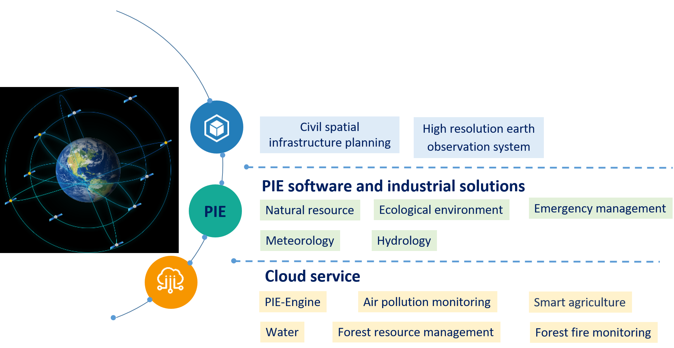
Introduction of PIESAT
With a long period of technological research and accumulation, PIESAT has been participating in the planning and construction of national civil spatial infrastructure projects.
Spatial infrastructure planning and construction

Slide 6
Introduction of PIESAT
PIE-Engine Remote Sensing Cloud Service Platform integrates remote sensing image processing technology with cloud computing, AI and other IT technologies, to provide one-stop remote sensing service for users. It takes advantages of cloud service (such as high efficiency, low threshold, low cost and easy access) to explore the full value of massive spatial data, and helps the decision-makers with fine supervision and decision-making.
Data acquisition
Data storage
Data processing/computing
Decision making
Publishing and sharing
Professional analysis
Production
Whole process on cloud
24/7 service
No professionals required
No professional equipment required
Easy login to use
Get what you need
Remote Sensing Monitoring Cloud Service

Slide 7
Introduction of PIESAT
Natural Resource
Meteorology
Marine Application
Water Management
Natural resource monitoring
Land security and monitoring
Precise meteorological forecast
Extreme weather warning
Marine ecological monitoring
Island and costal monitoring
Water resource monitoring
Flood and drought monitoring
Soil and water conservation monitoring ……
Emergency Management
Ecological Environment
Consultation
Smart Agriculture
National risk census
Disaster risk monitoring
Disaster early-warning
Air pollution monitoring
Ecological reserve projection
Satellite engineering project
Feasibility analysis
Preliminary design
Plantation management
Growth monitoring
Agricultural disaster monitoring
UAV
Land Resource
More…
UAV manufacturing
Flight operation
UAV data processing
Land use change detection
Illegal mining monitoring

Slide 8
CONTENTS
1
Introduction of PIESAT
2
PIESAT “Nuwa” constellation
3
Introduction of PIE-NWP
4
Remote sensing data applications

Slide 9

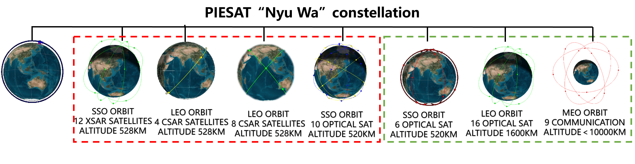
“Nuwa” constellation
INTRODUCTION
Hybrid radar satellite constellation contains 69 satellites.
  4 XSAR satellites (2023),
  34 SAR and optical satellites (2024)
  31 optical and communication satellites (2027)
Nuwa
4 XSAR SATELLITES
ALTITUDE 528KM

Slide 10
Mission Objectives
MISSION OBJECTIVES
Build a commercial satellite constellation to provide multi-target，multi-scale，multi-feature，all-day，all-weather and full spectrum real time remote sensing information acquisition，reserve national strategic resources；
Build a real time global remote sensing information communication platform. Increase the market occupancy in global remote sensing industry；
Create space-sky-ground-application integrated Industrial ecology, and world leading commercial aerospace technology corporation.

Slide 11
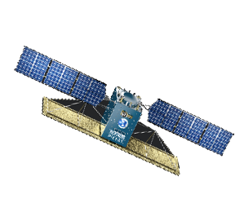
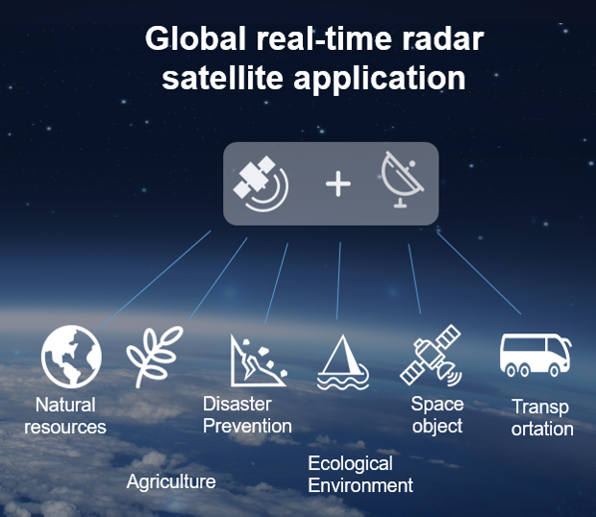
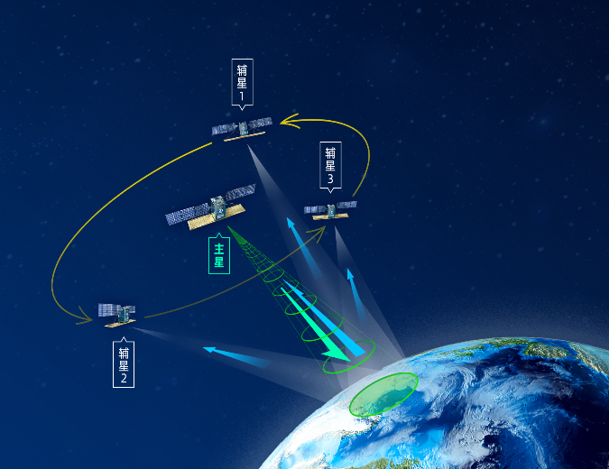
Mission Objectives
MISSION OBJECTIVES
Provide high resolution remote sensing data in all days and all weathers;
Laser communication：establish global networking，and high speed information hub；
Spatial datum ：provide spatial and temporal information

Slide 12
Construction Plan
MISSION OBJECTIVES
2023.09
“1+3”satellite constellation finishes test run and operation
2025.03
4 optical satellites arrangement
4 C-SAR satellites arrangement
2027
Second mission global operation
2023.03
Project Initiation
2024.06
8 X-SAR satellite arrangement
2025.09
First mission global operation
In Sep 2025, 34 remote sensing satellite in this constellation will finished the test run and build a network with the “1+3”satellite constellation launched in 2023.

Slide 13
Introduction of PIESAT-01
INTRODUCTION
PIESAT-01 Constellation
Sun synchronous orbit，satellite altitude 528 km
“1 primary satellite+3 moving satellites (one plane)”InSAR satellite system scheme.
High-accuracy topographic surveying, high resolution wide swath images, DEM deformation detection and three-dimensional imaging.
PIESAT-01
2023.03.30

Slide 14
SATELLITE PARAMETERS
Global satellite coverage，increase the frequency of deformation surveying between 53°N and 53°S
High-speed data transmission，and maximum 108GB data retrieved per track
 | X-SAR | C-SAR | OPTICAL
Functions | Imaging observation, deformation surveying | Imaging observation, deformation surveying | Remote sensing monitoring and on-orbit service
Spatial range | 84°N~84°S | 53°N~53°S | Global
Number | 12 | 4+8 | 10
Polarization | X-SAR, full-polarization | C-SAR, full-polarization +simple polarization | Spatial resolution 0.5m
Altitude | 520km | 542km | 520km
Weight | 500kg | 500kg | 300kg
Power consumption | <500W(Average 660W) | 4430W（Payload 3300W） | 3500W
Transmission rate | 2*1200Mbps（Adjustable） | 2*1200Mbps（Adjustable） | 2*1200Mbps（Adjustable）
Design lifetime | 5 years | 5 years | 5 years

Slide 15
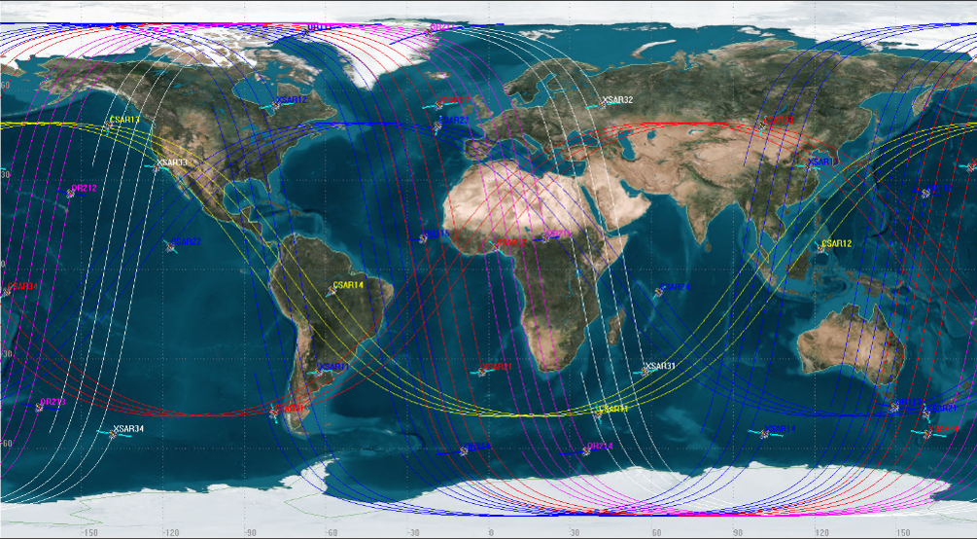
CONSTELLATION FUNCTIONS
The satellite network after all the satellites are launched.

Slide 16




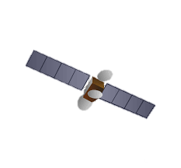









SPACE-GROUND-APPLICATION
MEO
Communication
＜10000km
Global real time coverage
Laser
4G/bps
Laser
4G/bps
Space
Laser
4G/bps
LEO
Optical
~1400km
Wide swath imaging
Laser
2G/bps
LEO
Optical/SAR
~500km
Quantitative remote sensing
Regional Coverage
Microwave
Cloud Service platform
Ground
Global data retrieval center
Control center, data service center
Ground based Augmentation
Application
Government
Enterprise
Research institutes
Other users

Slide 17
CONTENTS
1
Introduction of PIESAT
2
PIESAT “Nuwa” constellation
3
Introduction of PIE-NWP
4
Remote sensing data applications

Slide 18
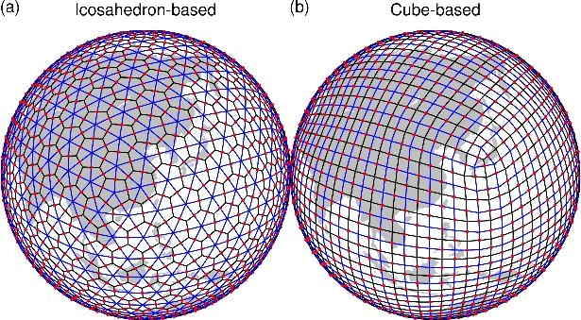
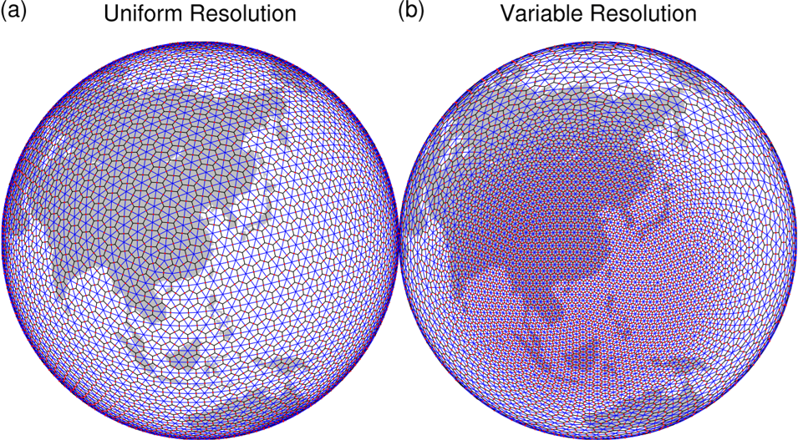
Introduction of PIE-NWP
GRIST (Global-to-Regional Integrated forecast System) is a unified model system for global weather and climate modeling.
GRIST-AMIPW: this setup couples GRIST with a high-resolution (down to km-scale) oriented physics suite for weather-to-climate forecast applications.
GRIST-AMIPC: this setup couples GRIST with a comprehensive, long-term climate-modeling oriented physics suite for multi-century applications.

Slide 19
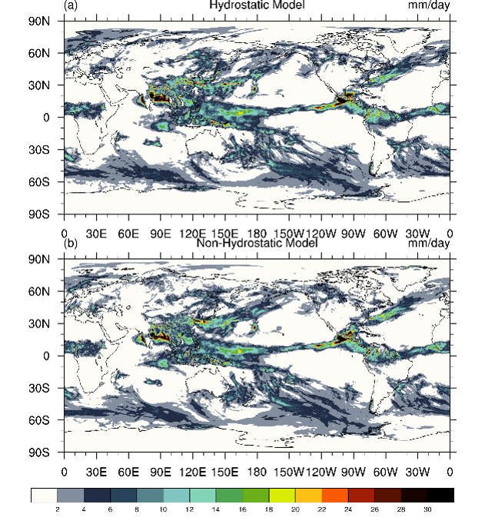
Introduction of PIE-NWP
In practice, because global weather and climate modeling differ significantly in terms of their spatial and temporal scales, the so-called unification is pursued following two routes:
(i) to maximize the possibility of constructing weather and climate models using a single model framework and dynamical core;
(ii) to maximize the possibility of using a unified model formulation with minimum application-specific changes for weather-to-climate forecast applications that are relevant to most operational business demands.

Slide 20
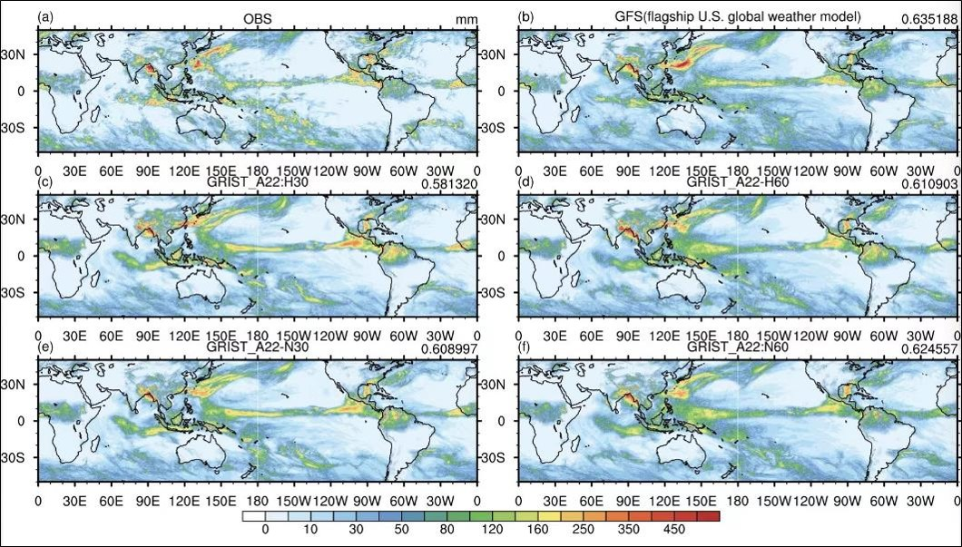
Introduction of PIE-NWP

Slide 21
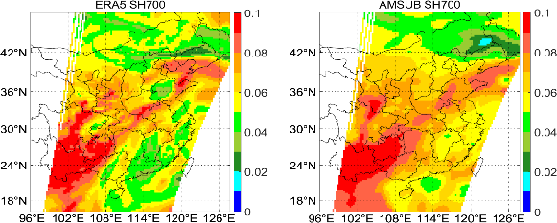
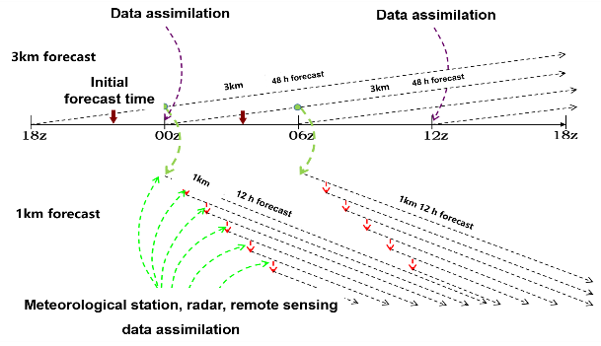
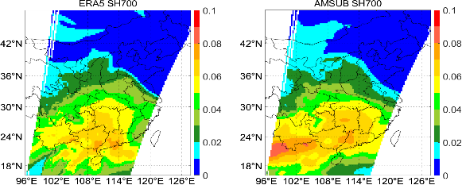
Introduction of PIE-NWP
The NWP system assimilates ground data，sounding data, radar, and remote sensing observations.

Slide 22
CONTENTS
1
Introduction of PIESAT
2
PIESAT “Nuwa” constellation
3
Introduction of PIE-NWP
4
Remote sensing data applications

Slide 23
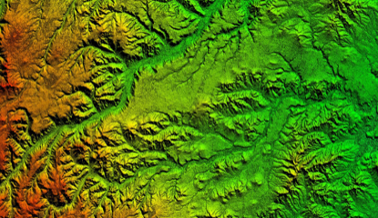
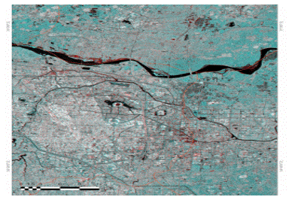
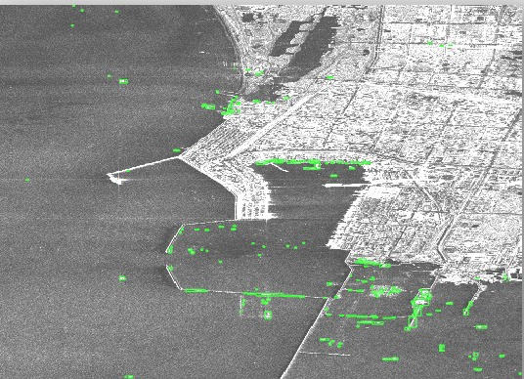
Remote sensing data applications
“Nuwa” satellite Constellation data can improve PIE-NWP forecast performance by updating DEM and land covers
High-precision terrain mapping, wide swath imaging, deformation monitoring 3-D images. Spatial resolution is 0.5m-5m.
Global DEM surveying accuracy higher than 1:50000，surface deformation monitoring accuracy is 3-5mm/year。
High-precision wide swath surveying. Imaging range 10km-300km，on-board imaging and target detection.
Improve the accuracy of land cover detection，overcome the drawback of low accuracy in NWP

Slide 24
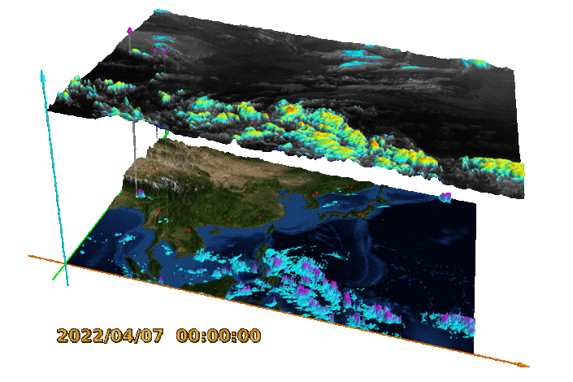
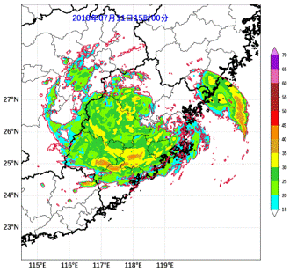
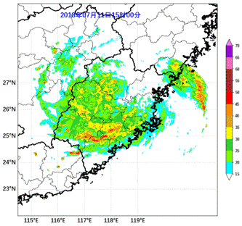
Remote sensing data applications
Meteorological data monitoring and forecast
Based on PIE-NWP as well as remote sensing observations including FY-3, FY-4 data and the “Nuwa” satellite data
3-D precipitation monitoring in extreme events

Slide 25
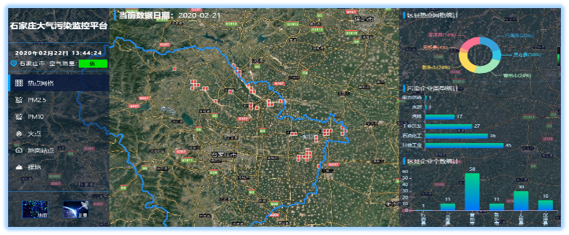
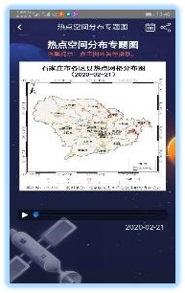
Remote sensing data applications
Air pollution remote sensing application
Air pollution is monitored once a day during non heating period, and multiple times per day during heating period, special renovation or emergency period as required. Monitoring parameters include air pollution hot spot grid, PM2.5 and PM10 concentration distribution, etc. The accuracy of PM particle concentration is 90%. Results will be published in chart and report. The service mode includes mobile app, social media announcement, etc.
Typical case study: Piesat has been providing air pollution remote sensing monitoring service for Shijiazhuang City since 2018.

Slide 26
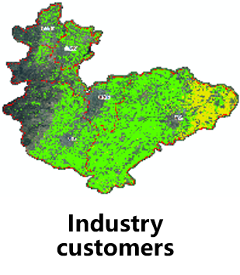
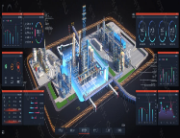

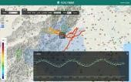

Remote sensing data applications
Hydrology
Agriculture
Marine
Forest
……
Government
Special
……
Government customers
Remote sensing and NWP products
Enterprise customers
Academic customers
Image processing researches
Data tracking
……
Individual customers
Maps and images
Apps
……

Slide 27
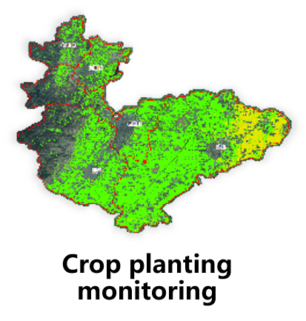
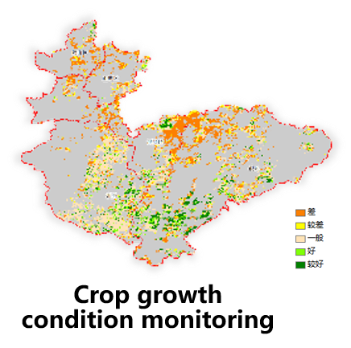
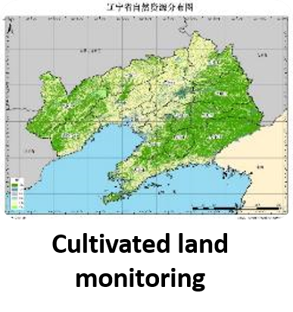
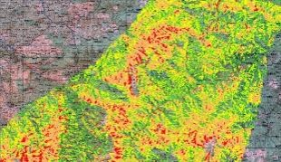
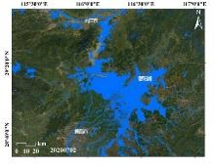
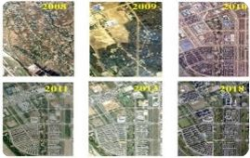
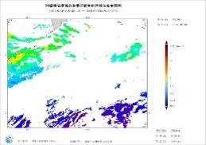
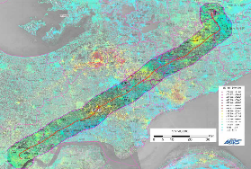
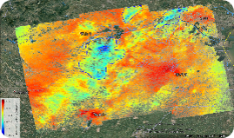
Remote sensing data applications
Plant diseases monitoring
Flood and drought monitoring
Groundwater control
Disaster recovery
Marine environment
Transportation

Slide 28
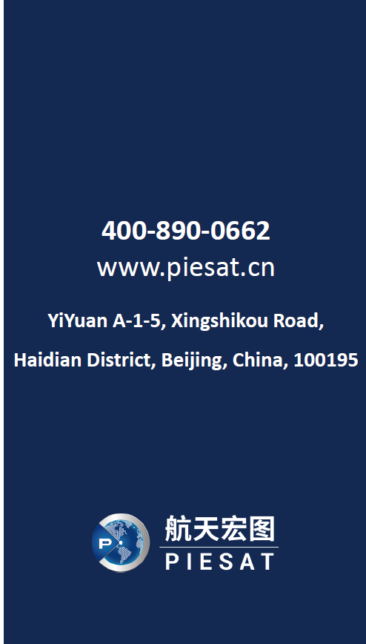
Thank you
Serve the Earth and Space Community

